Slide 1
RATE THE PROFESSOR
iTech4Leif

Slide 2
Our Goal
A web application which allows students from various universities to rate their lecturers.
A platform where prospective students could use the ratings to evaluate potential courses.

Slide 3
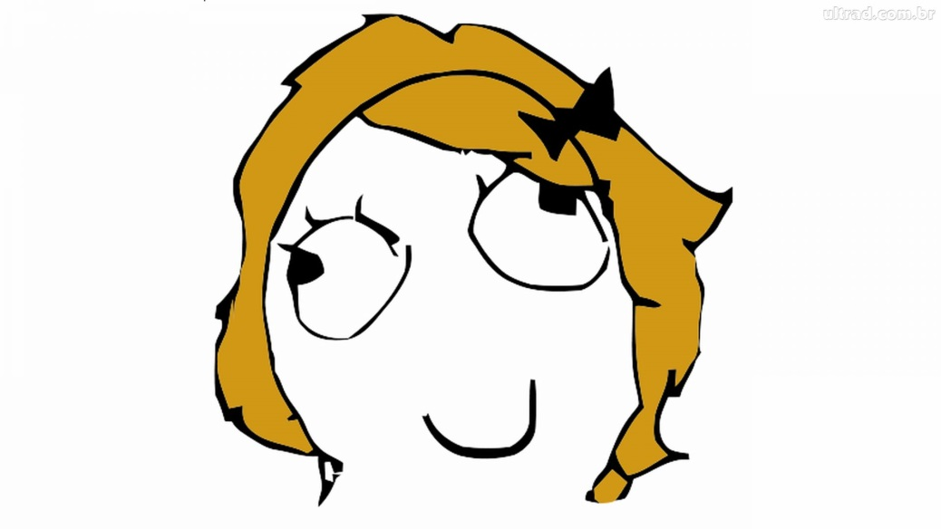

Our Users
Jenny Wright, 22
Ryan Smith, 17

Slide 4
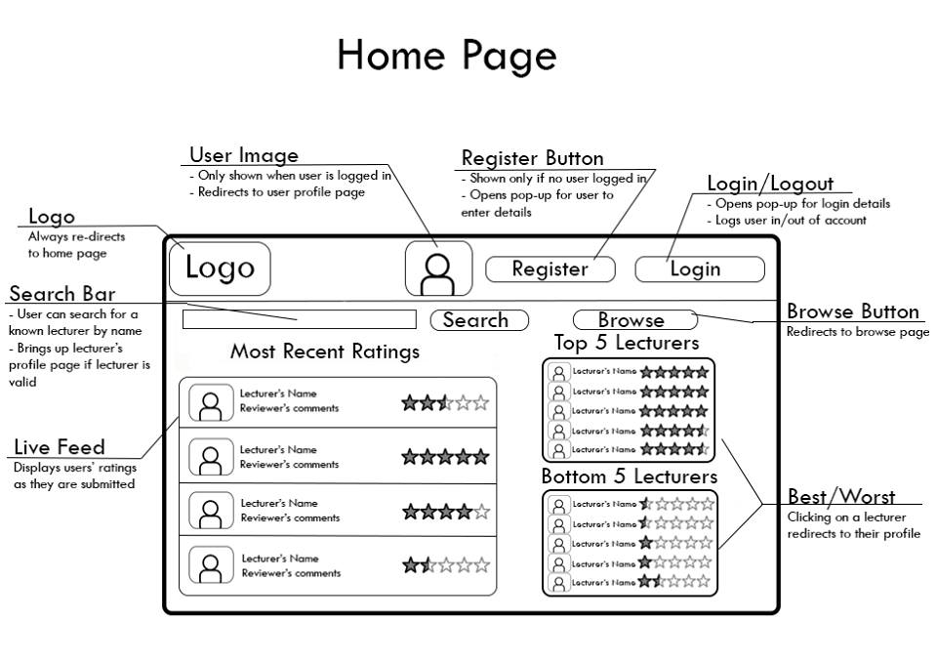

Slide 5
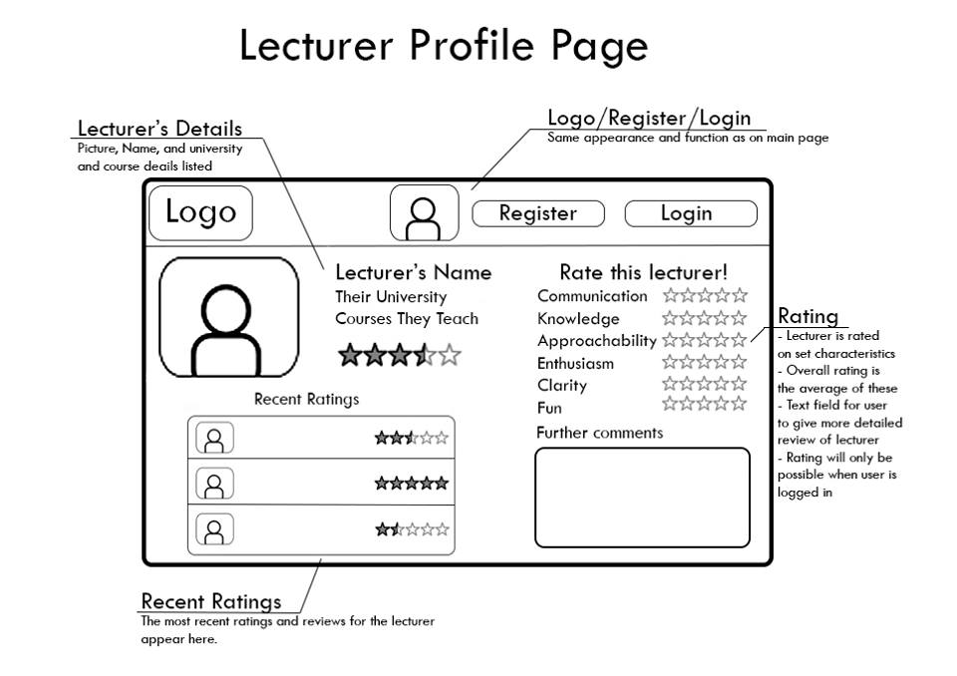

Slide 6
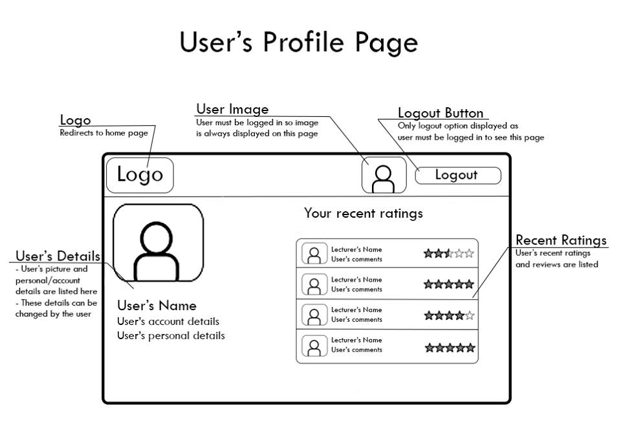

Slide 7
What makes us stand out
The application has a clean, easy to use interface
Has a well defined need identified in the student community and it is scalable
We will make sure the application is stable and reliable to ensure a smooth user experience

Slide 8
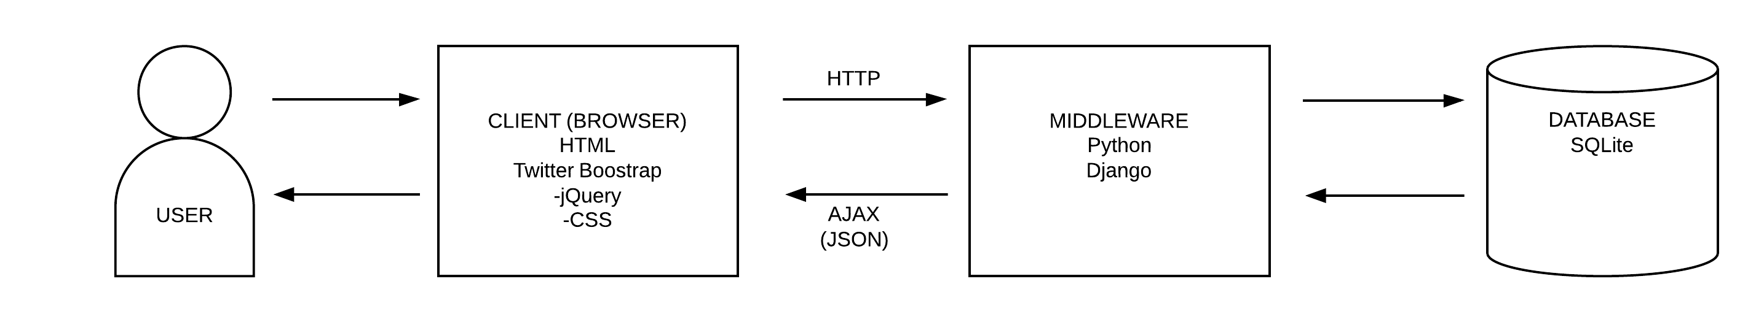
Three-Tier System Architecture

Slide 9
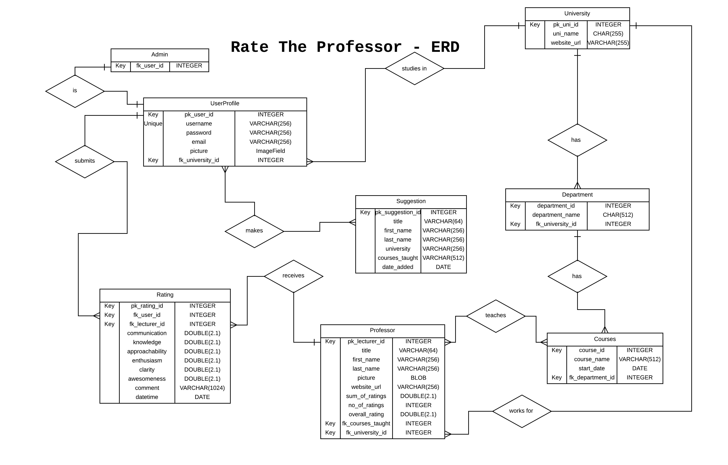

Slide 10
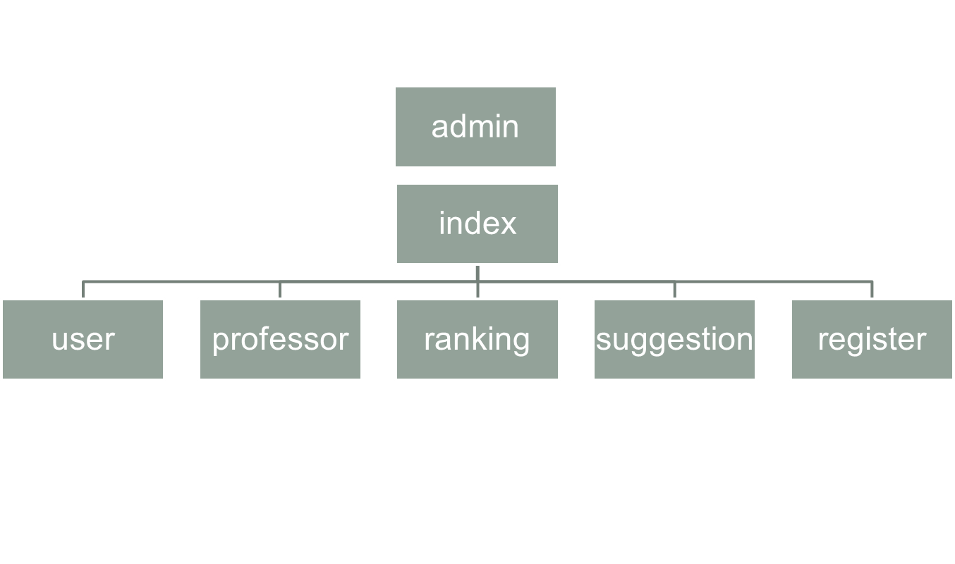
Site Map

Slide 11
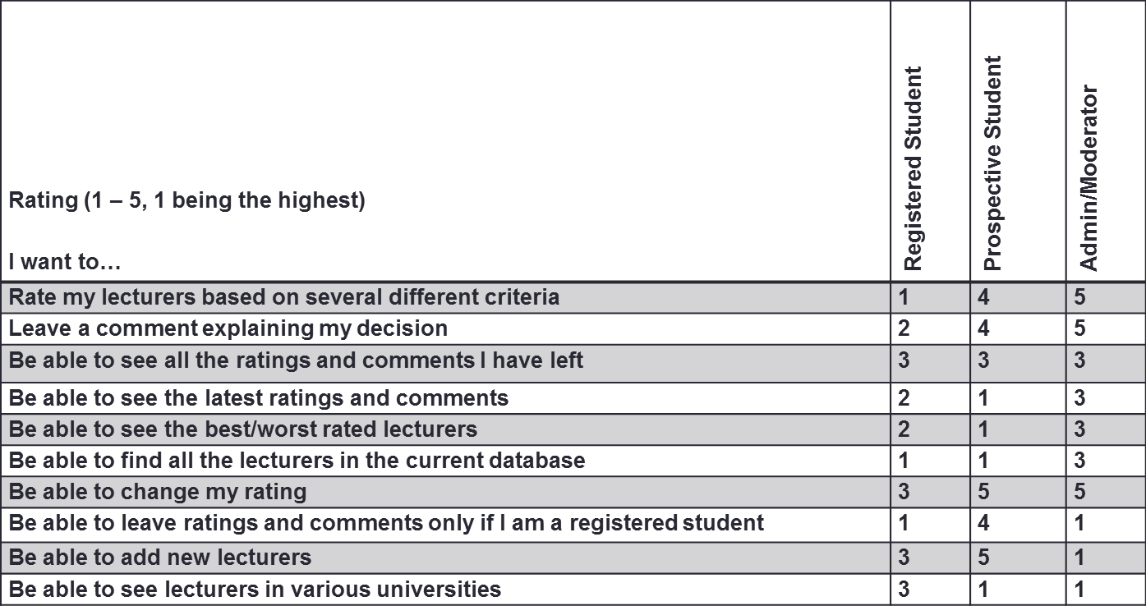
User Needs Matrix

Slide 12
Spec List (MoSCoW)
The client would like to create a site to let registered students
to rate lecturers based on several criteria. (MUST)
Registered students would be able to leave comments about the lecturers. Unregistered students will be only able to browse. (MUST)
The site should allow for students to search for lecturers. (MUST)
To register students will need to provide a valid
university email. (MUST)
The admin should be able to add new lecturers. (MUST)
It should let users see a list of the latest ratings and
Comments. (SHOULD)

Slide 13
Spec List (MoSCoW)
It should let users see a list of the best/worst rated
lecturers.(SHOULD)
The front page should present the latest comments,
the best/worst rated courses, and some form of
search/navigation of courses. (SHOULD)
The email should be confirmed, before they can add
ratings. (SHOULD)
The admin of the website should be able to add
in different universities, and the email domain for
legit universities. (SHOULD)
Some check to make sure the lecturer has not already
be added should be put in place. (COULD)
Students will be able to reply to other students’ comments (WON’T).

Slide 14
User Personas
Silvia Wright, 22
Ryan Smith, 17
Psychology student, interested in early childhood development. In her free time she chats and gossips with her friends on Facebook. Occasionally she goes to clubs with a group of her best friends. Often she is too shy to speak her mind but anonymously on the internet she expresses her strongest opinions on any subject. In the future she wants to have a fab wedding.
Secondary school student and a computer geek. He spends most of his time playing games or randomly surfing the internet. At school he is ok with technical subjects but he hates writing essays. He does not take part in any debates not involving his field of interest. He doesn't know what to study at the university, therefore he wants to do proper research on the web.

